Slide 1
COMBINATIONAL CIRCUITS
COMPUTER SYSTEM ARCHITECTURE
BY:
ROSHNI PATOA

Slide 2
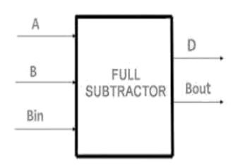
FULL SUBTRACTOR
Full subtractors are fundamental building blocks in digital circuits
Used to subtract three binary digits: A, B, and C
Produces two outputs: Subtract and Borrow
Essential component for arithmetic operations in computers

Slide 3
Inputs and Outputs
Inputs: A, B, C (bits to be subtracted)
Outputs:
Subtract, Borrow
Total possible input combinations: 2³ = 8

Slide 4
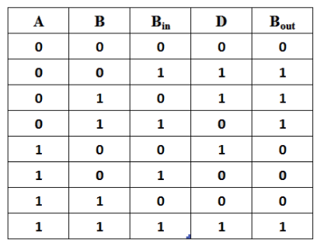
Truth Table for FULL SUBTRACTOR

Slide 5
Logic Gates in FULL SUBTRACTOR
XOR gates: Used for generating Subtract
AND gates: Used in Borrow generation
OR gate: Combines Borrow terms

Slide 6
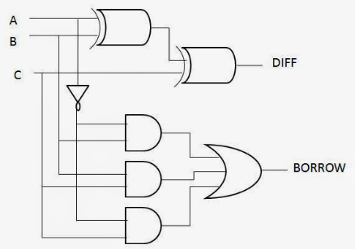
FULL SUBTRACTOR Circuit Diagram

Slide 7
BOOLEAN EXPRESSIONS FOR FULL SUBTRACTOR
Input A, B, C
Subtract = A ⊕ B ⊕ C (⊕ represents XOR operation)
Borrow = A’B + A’C + BC

Slide 8
Example 1
Inputs: A = 1, B = 0, C = 0
Step through the circuit
Calculate Sub: 1 ⊕ 0 ⊕ 0 = 1
Calculate Borrow: 1’.0 + 1’.0 + 0.0 = 0
Result: Sub = 1, Borrow = 0

